Slide 1

SUSTAINABLE CITIES AND COMMUNITIES
Team: Shingles All The Way
Team Members:
Pulkit Varshney (114709284)
Pratik Thorwe (113221363)
Saurabh Parekh (114356444)
Purva Makarand Mhasakar (114354303)

Slide 2




GOALS
Notes:
Enhance inclusive and sustainable urbanization and capacity for sustainable human settlement
Reduce the adverse per capita environmental impact of cities by paying attention to air quality
Provide universal access to safe, inclusive and accessible, green and public spaces
Support least developed countries in sustainable and resilient development though financial and technical assistance

Slide 3
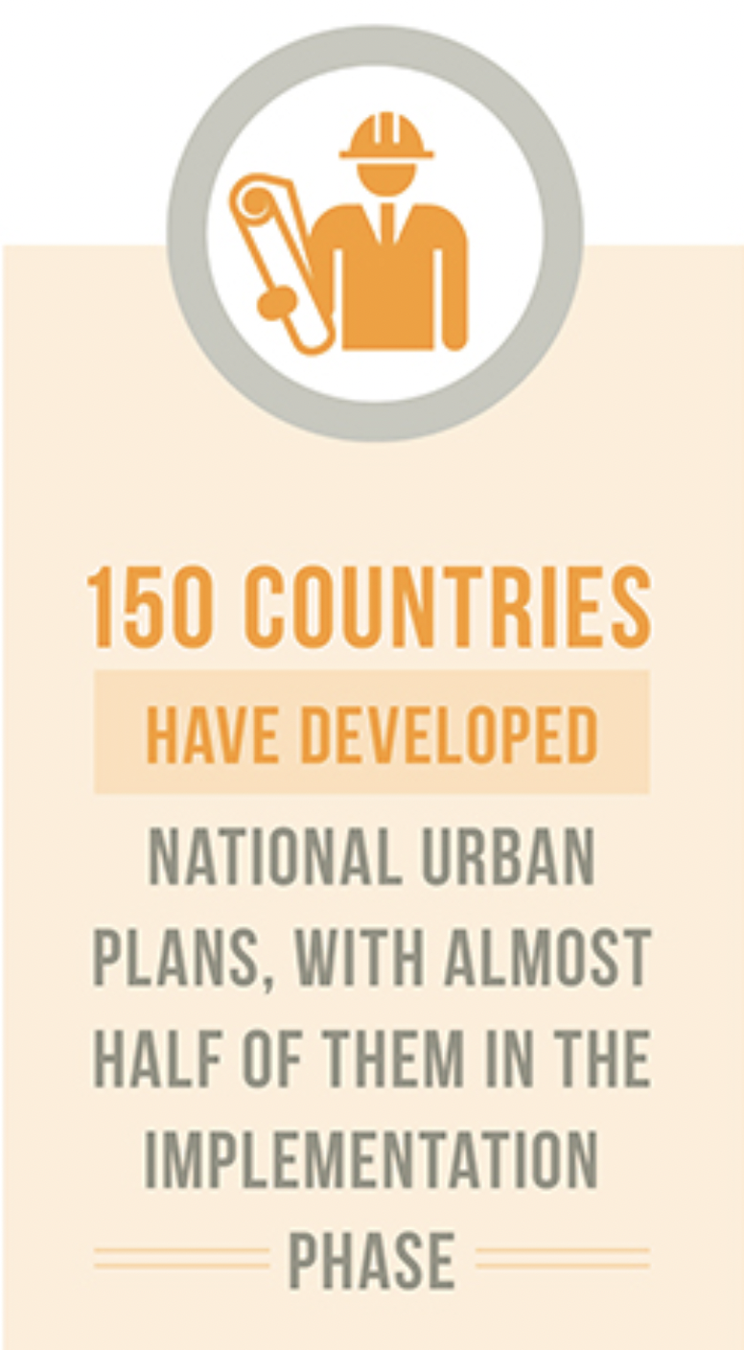
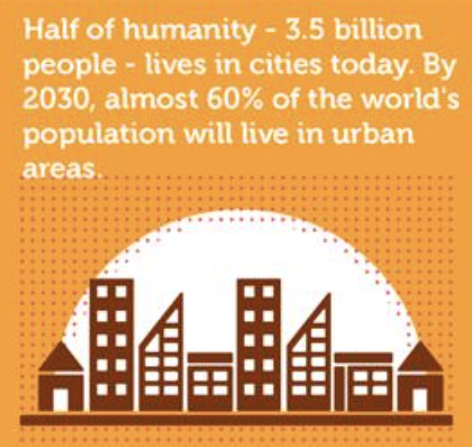
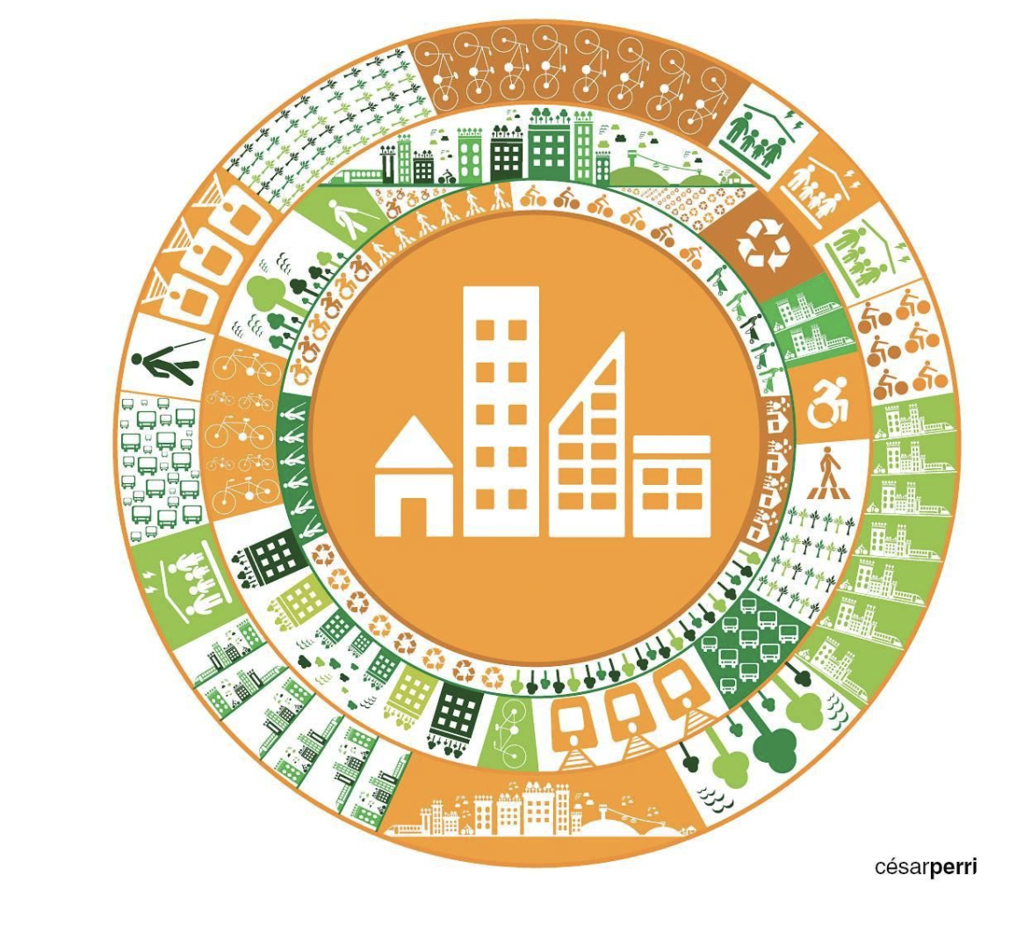

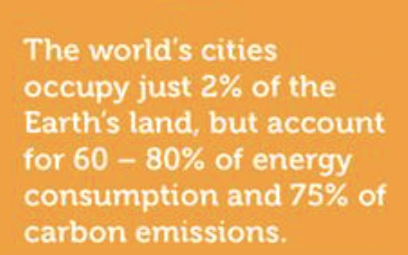
WHY DO WE CARE?
Notes:
3.9 billion people live in cities globally. 5 billion people will live in cities by 2030.
Cities occupy 3 percent per cent of the Earth's land. Yet they still account for 60–80 percent of energy consumption and 75 percent of carbon emissions.
By 2050, about 70% of the world’s population is expected to live in urban areas.

Slide 4
BACKGROUND
“Are we on the right path to achieve the sustainable development goals”,
Jonathan D.Moye et al. [10]
“Spark Big Data Analysis of World Development Indicators”, Kunal Pritwani et al [12]
“How to Contextualize SDG 11? Looking at Indicators for Sustainable Urban Development in Germany”, Florian Koch et al.[20]
“Detection of Water-Bodies Using Semantic Segmentation”, Mina Talal et al.[9]

Slide 5
DATA DESCRIPTION
DATASET | DESCRIPTION | SIZE
World Development Indicators Database [13] | Structured data for Spark Similarity Search, Hypothesis Testing and Time Series Feature Prediction | 30,00,000 Rows x 60 Columns
Multi-Temporal Urban Development SpaceNet Dataset[7] | Unstructured Time Series data of 100 unique geographical areas covering nearly 40,000 square kms of area | 3047 Images, 20.11GB
Semantic Segmentation of Aerial Imagery[14] | Dataset is used for training forest and land detection models. Consists of MBRSC satellite-captured images | 72 Images, 33.5MB

Slide 6
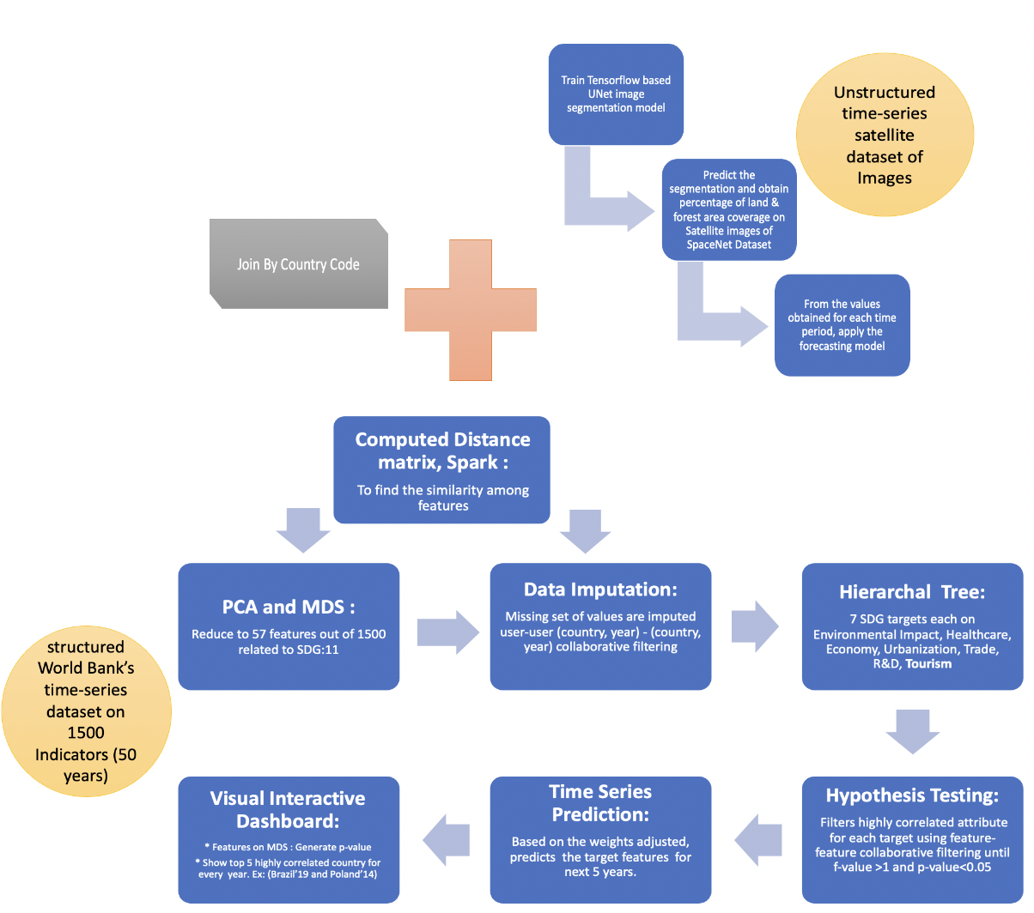
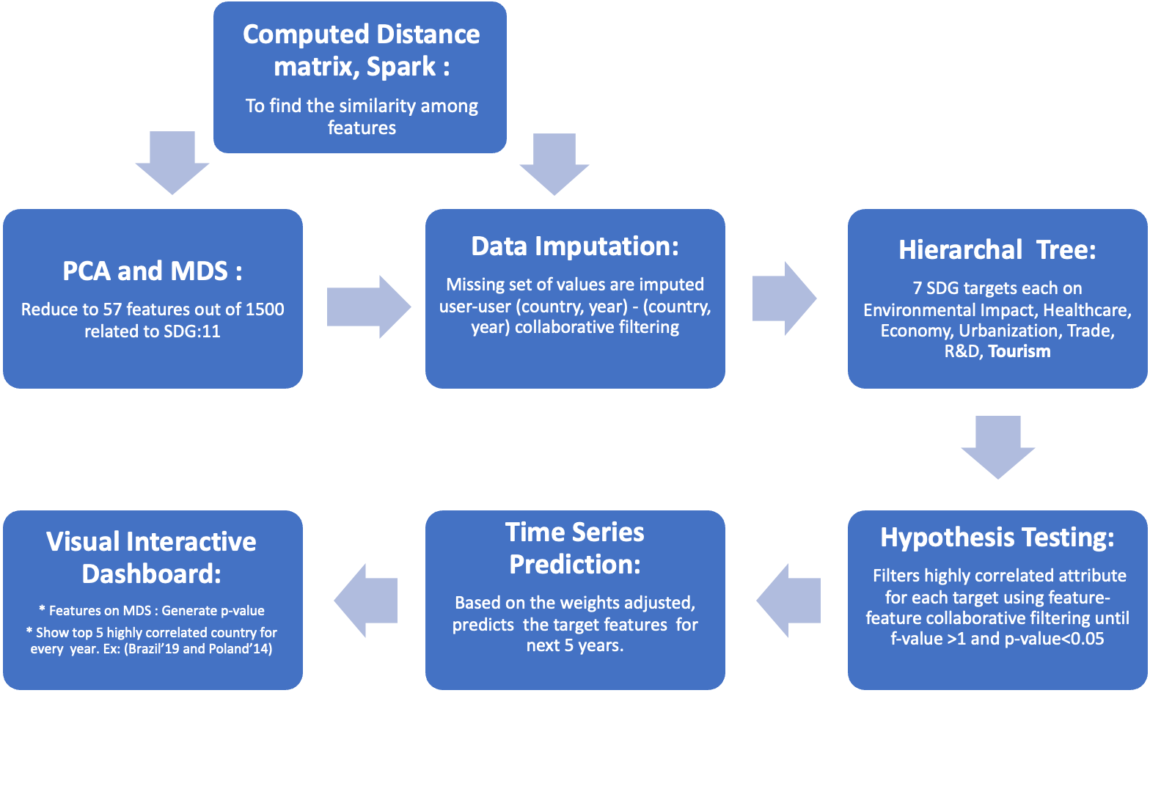
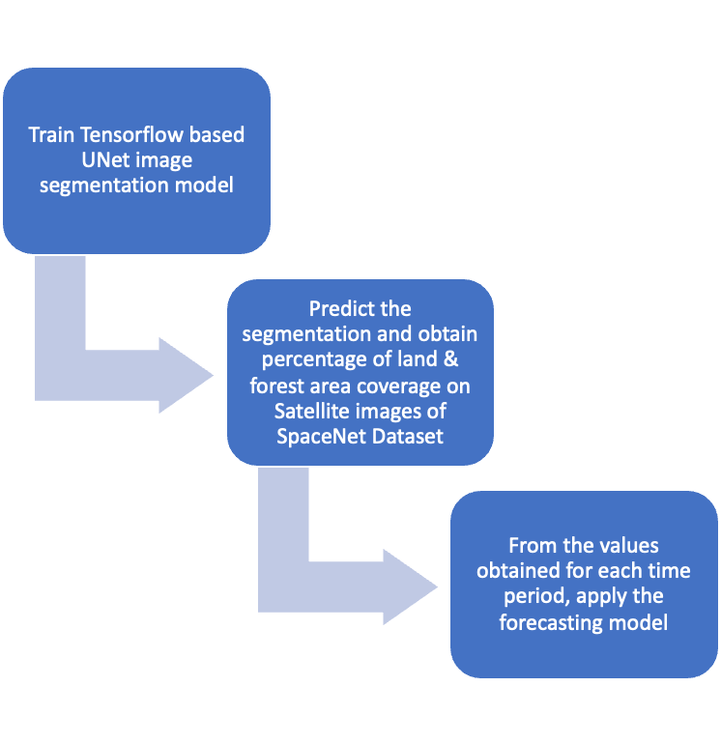

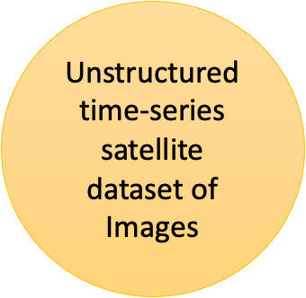
ARCHITECTURE
Country Code

Slide 7
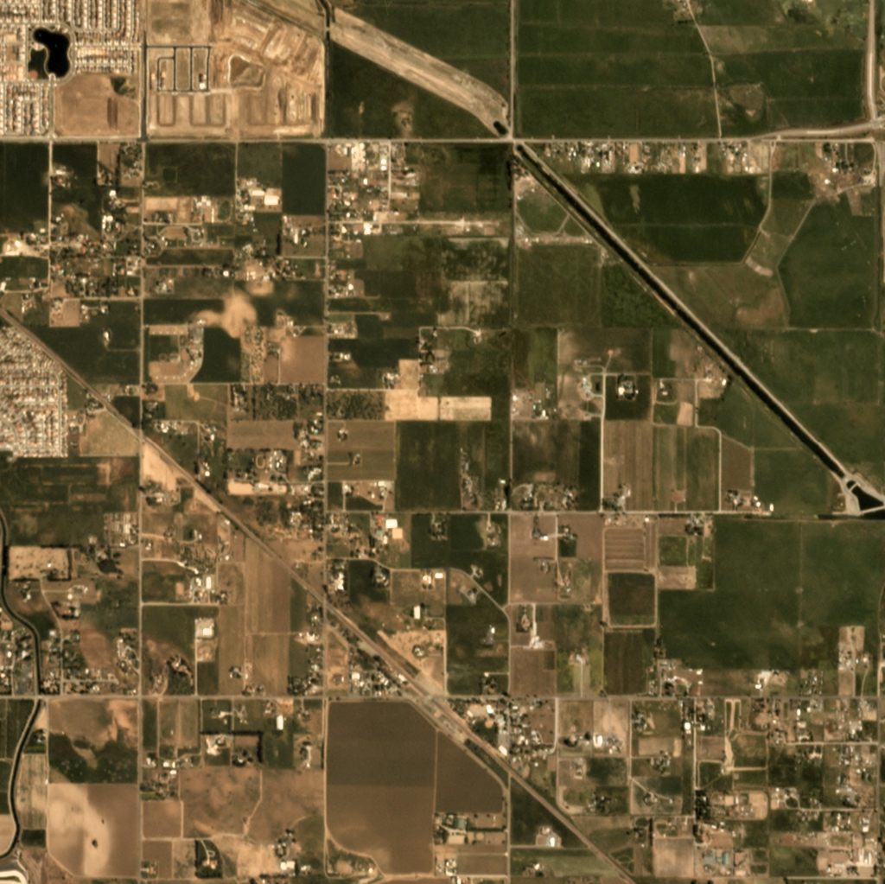
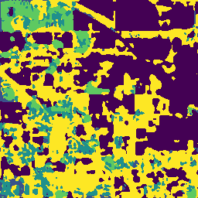
METHODOLOGY
Convert unstructured data to structured data using Tensorflow:
Image segmentation on the time series satellite images of the Multi-Temporal Urban Development SpaceNet dataset.
Train the UNet architecture mode on the Semantic segmentation of aerial imagery dataset.
Calculate the percentage of greenery and urban land area coverage.
Satellite Image Image Segmentation

Slide 8
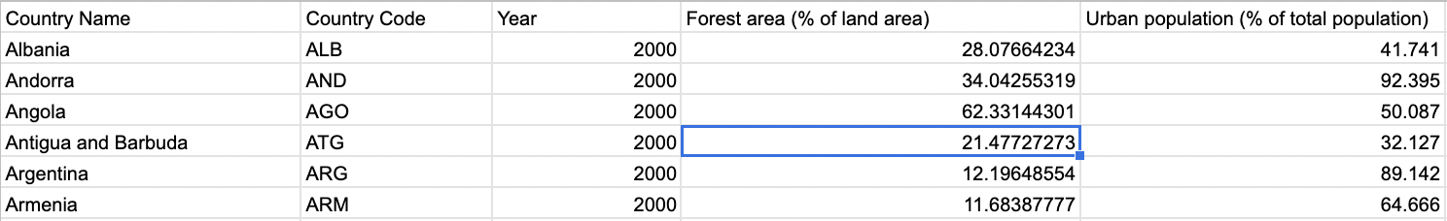
METHODOLOGY
2. Find highly correlated countries with time and impute missing values by Similarity Search:
We standardize the data using min-max scalar, finds all-pair cosine similarity, filters top 100 highly correlated users(countries with year), imputes the missing values, converts rdd to csv again for hypothesis testing.
For the selected set of features, one good analysis comes out- we can compare countries' growth in a year wrt to another country’s growth in a different year.
Imputed Value

Slide 9
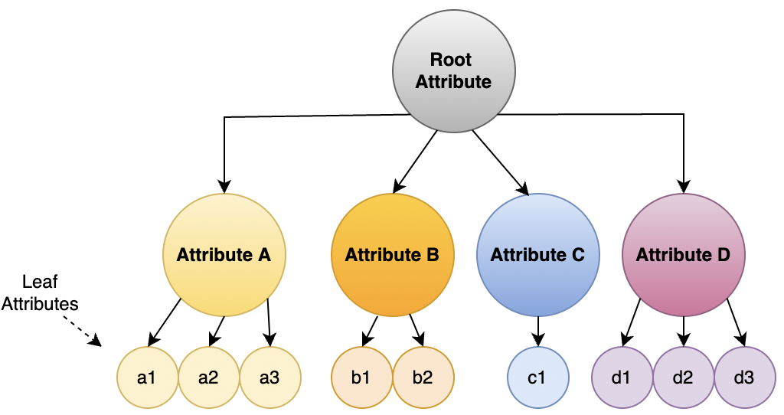
METHODOLOGY
3. Generate root Hypothesis and perform hypothesis testing on it :
Shortlist the key attributes ‘Y’, responsible for sustainability
Create a hypothesis that ‘Y’ is not depended on any other attribute
Test the hypothesis using Multiple Linear Regression
Obtain the attributes ‘Xs’ responsible to control ‘Y’

Slide 10
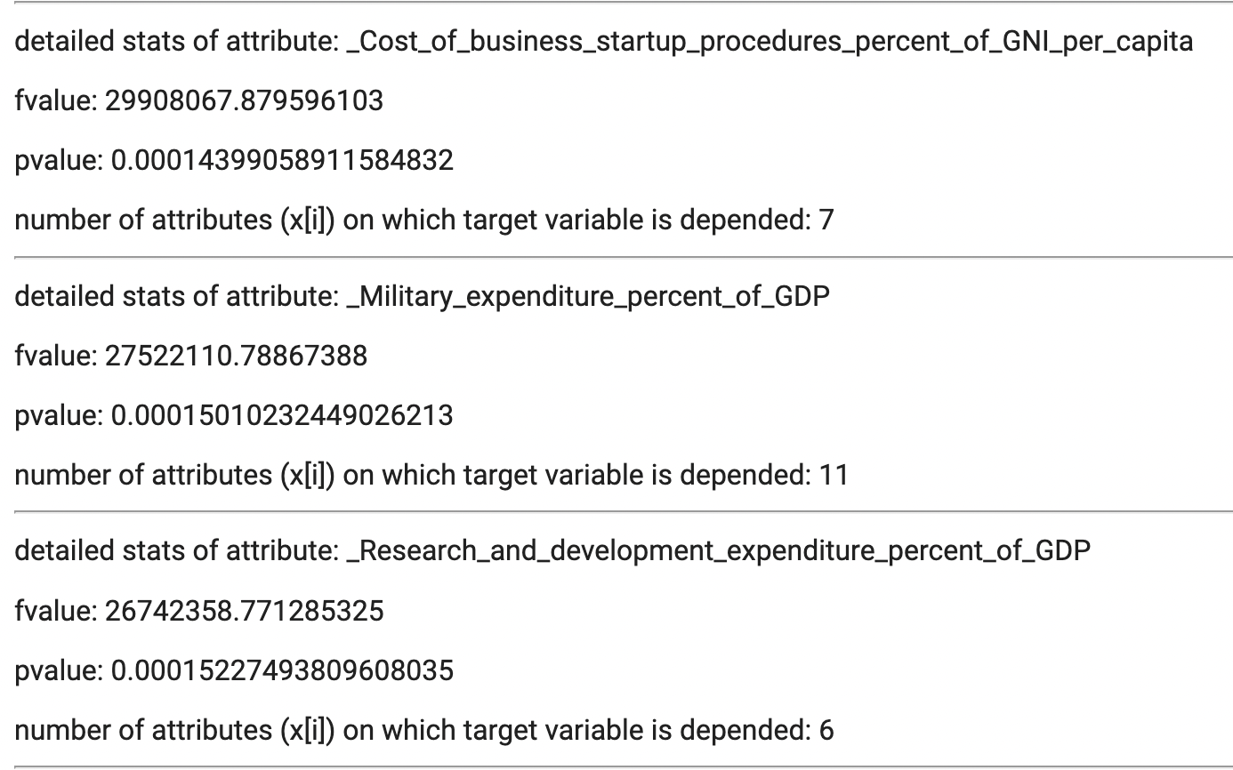
METHODOLOGY
4. Generate a Hypothesis tree to test all the hypotheses:
We test the root hypothesis & obtain the attributes on which the root hypothesis is depended.
Based on these attributes we recursively perform hypothesis testing to find the child attributes on which the concerned parent depends.
Next, we reach the leaf nodes of our hypothesis tree which contains the base attributes that govern our root attribute.

Slide 11
METHODOLOGY
5. Recommend the changes for the coming years in the attributes to govern the required change in the root hypothesis :
Based on the hypothesis tree, we predict the values of the attributes for the next 10 years using the Autoregressive Integrated Moving Average(ARIMA) model.
We use the ACF and PACF plots to decide whether to include an AR term(p), MA term(q), or both.
Finally, we build the model and forecast the values for the next 10 years.

Slide 12
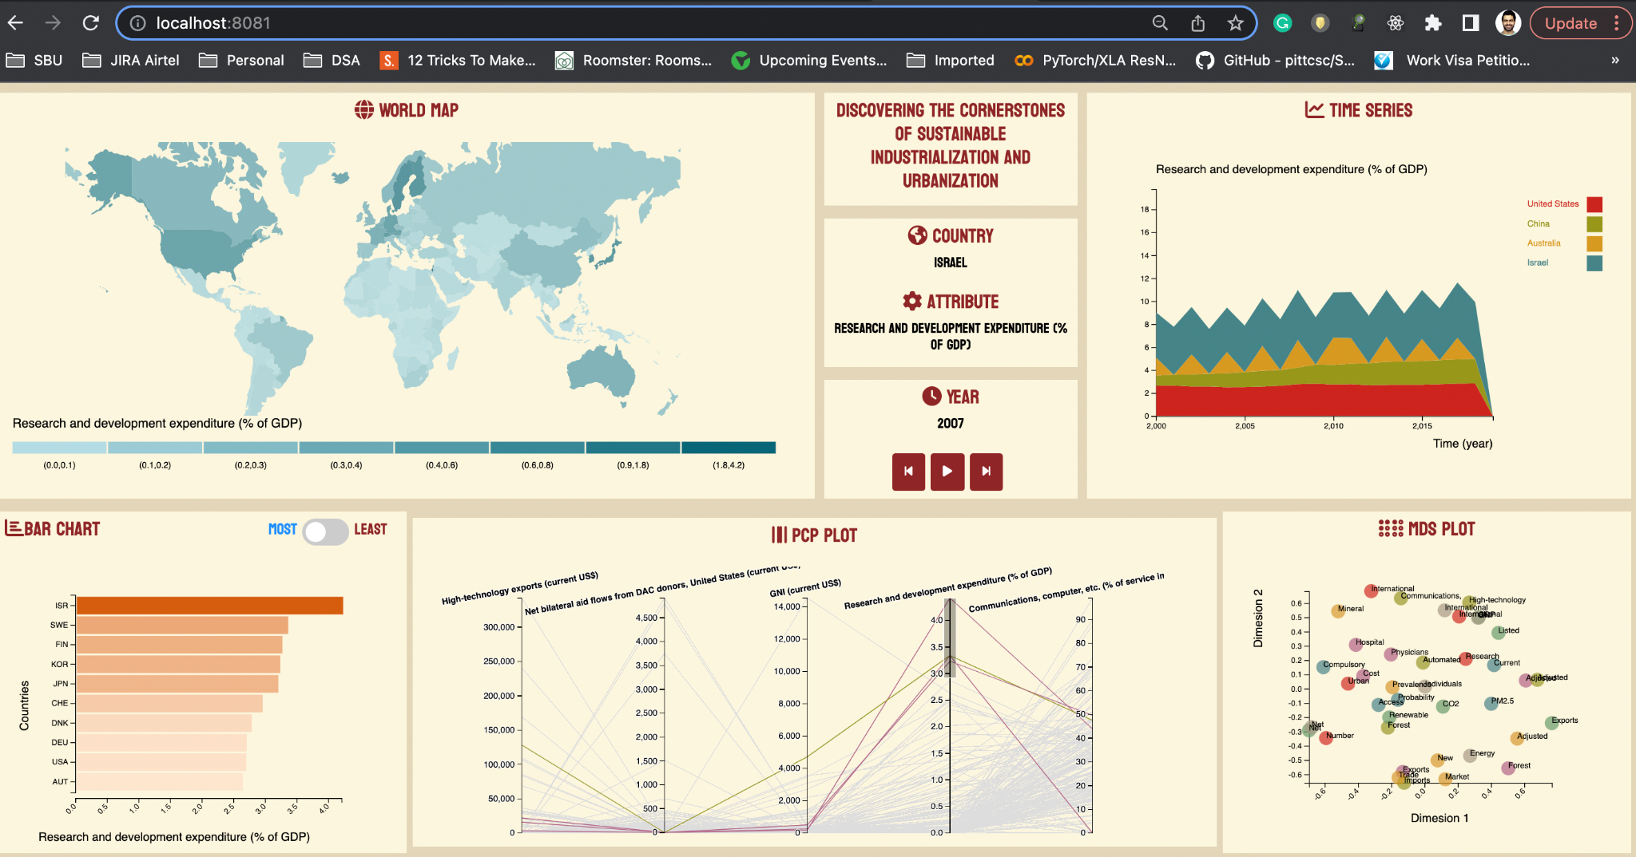
RESULTS

Slide 13
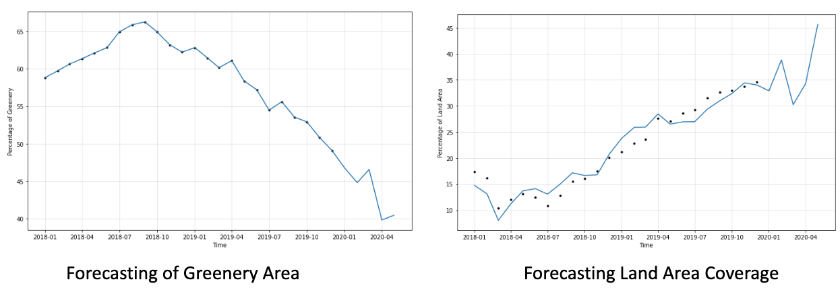
RESULTS- Predictions
Forecasting for Louisiana, USA

Slide 14
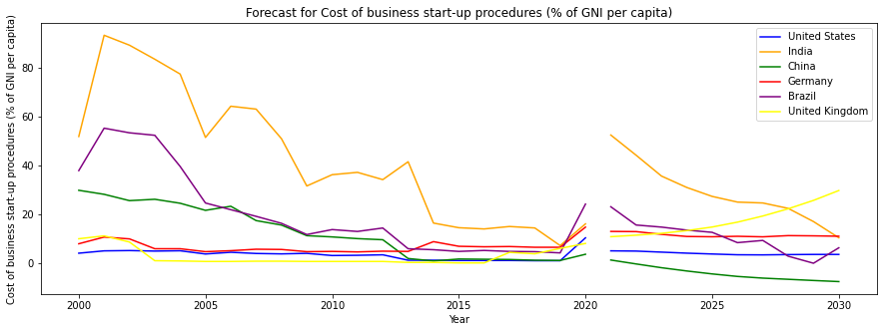
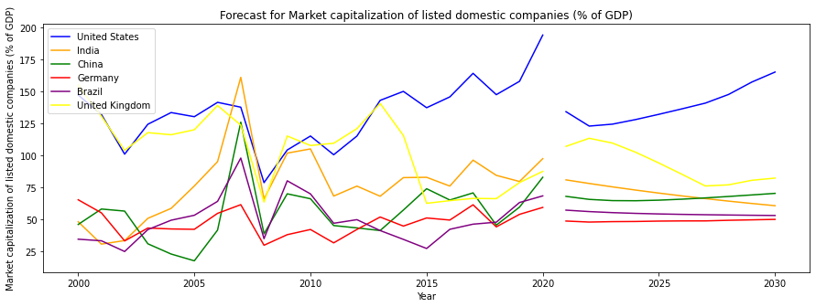
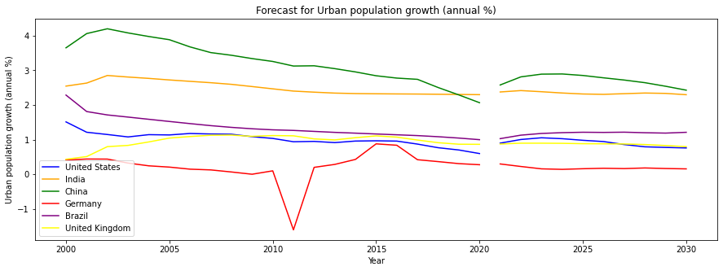
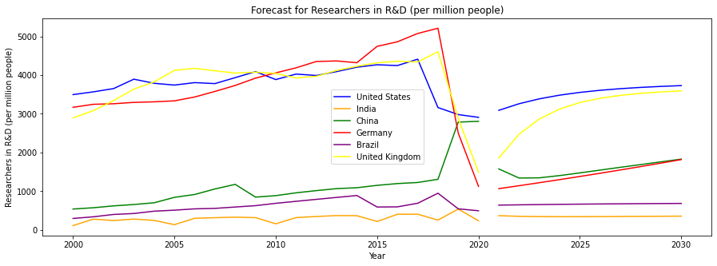
RESULTS - Predictions

Slide 15
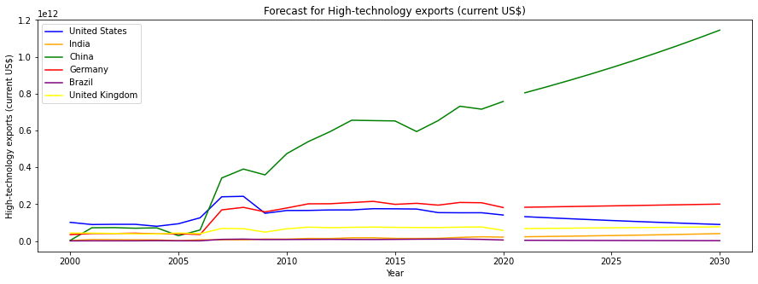
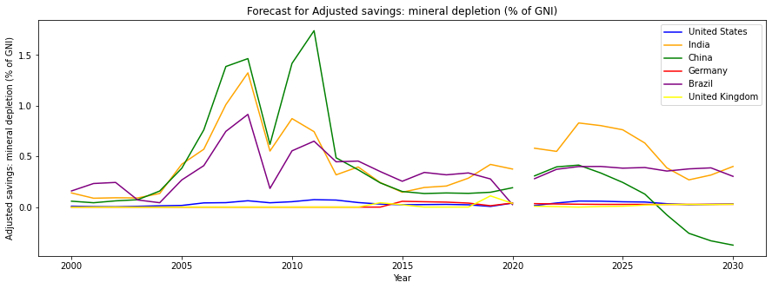
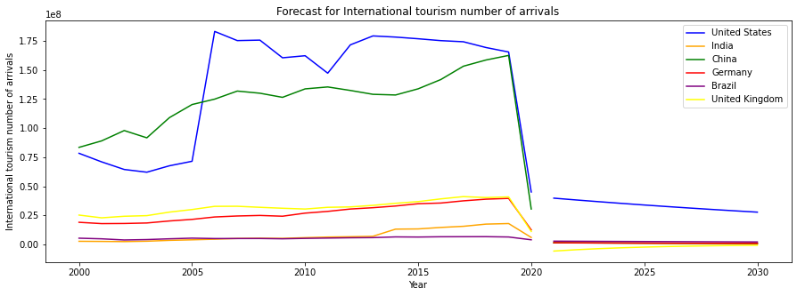
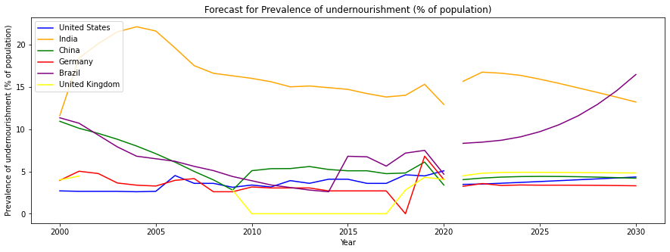

Slide 16
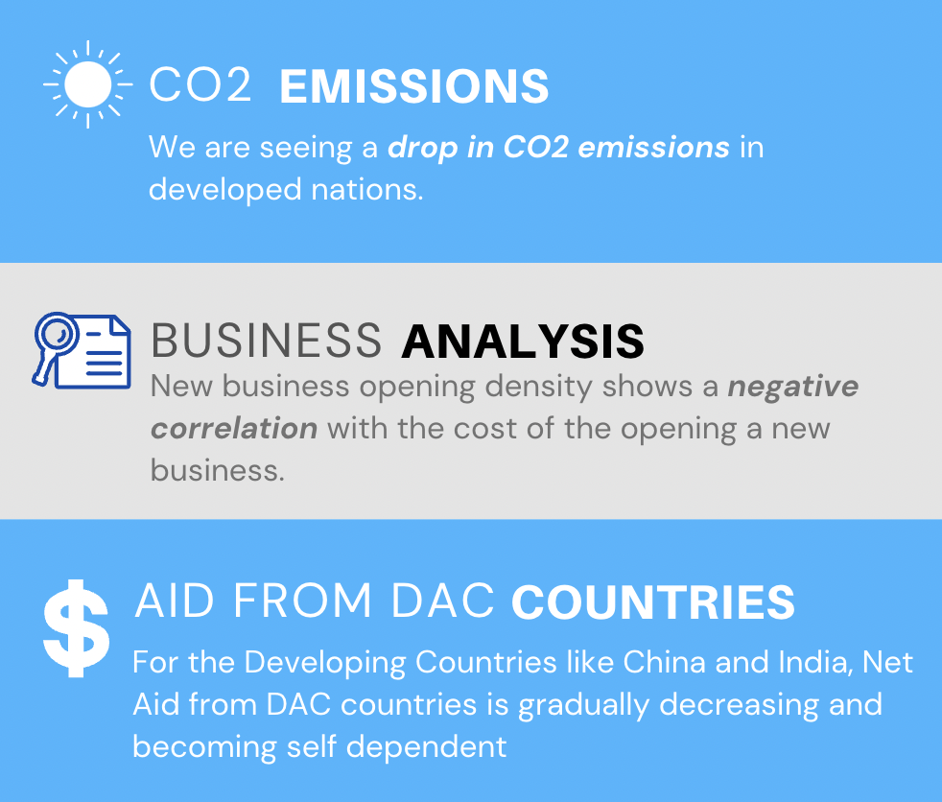
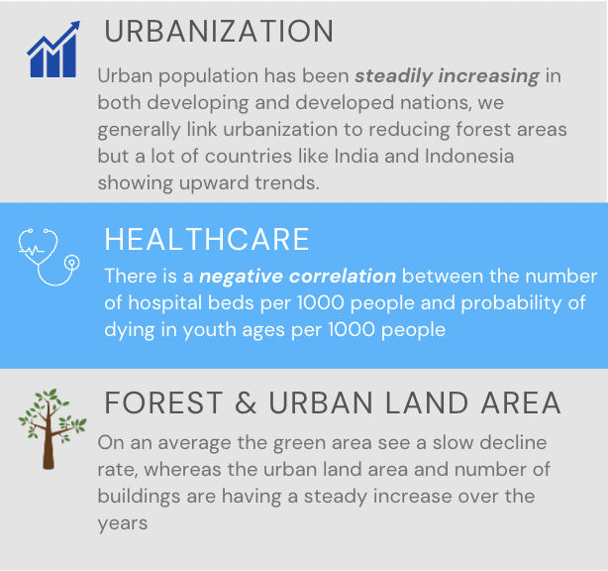
RESULTS

Slide 17
CONCLUSION
01
Performed Similarity search (S)
Identified attributes (Xs) responsible for sustainability
Obtained Sustainable Cities
02
Identified attributes responsible for dependency (Y)
Tested our hypothesis (H) that with sustainability in cities, country’s dependency reduces
Obtained dependency of Y on Xs
Reduced dependency over developed countries
03
Predicted trends in Xs based on (S)
Predicted trends in Y based on Xs
Obtained important traits required for a country’s sustainable growth
Moved towards Sustainability in the developing countries

Slide 18
REFERENCES
https://www.exergycapital.com/
https://www.totabc.org/sdg/sustainable-cities-communities
https://twitter.com/mgtc_my/status/1040142804452749313
https://sdgs.un.org/goals/goal11
https://www.un.org/sustainabledevelopment/cities/
https://www.mdpi.com/2072-4292/11/23/2803
https://openaccess.thecvf.com/content/CVPR2021/papers/Van_Etten_The_Multi-Temporal_Urban_Development_SpaceNet_Dataset_CVPR_2021_paper.pdf
https://www.hindawi.com/journals/cin/2022/5008854/
https://ieeexplore.ieee.org/abstract/document/8642743
https://www.sciencedirect.com/science/article/pii/S0305750X19303985
https://link.springer.com/chapter/10.1007/978-981-10-7515-5_19
https://computerresearch.org/index.php/computer/article/view/1771
https://databank.worldbank.org/source/world-development-indicators
https://humansintheloop.org/resources/datasets/semantic-segmentation-dataset/
https://www.kaggle.com/datasets/humansintheloop/semantic-segmentation-of-aerial-imagery
https://facebook.github.io/prophet/
https://towardsdatascience.com/u-net-for-semantic-segmentation-on-unbalanced-aerial-imagery-3474fa1d3e56
https://github.com/amirhosseinh77/UNet-AerialSegmentation
https://github.com/dead-pool-kit/CSE-545-final-project
https://www.mdpi.com/2220-9964/7/12/464

Slide 19
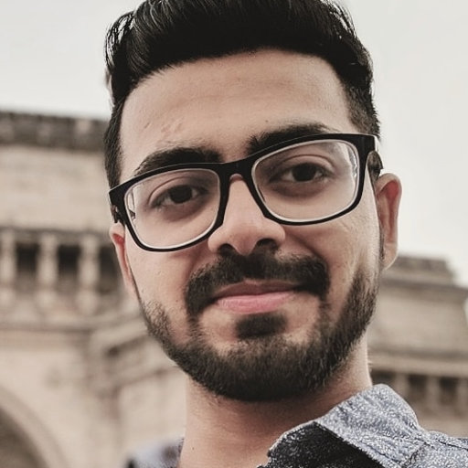
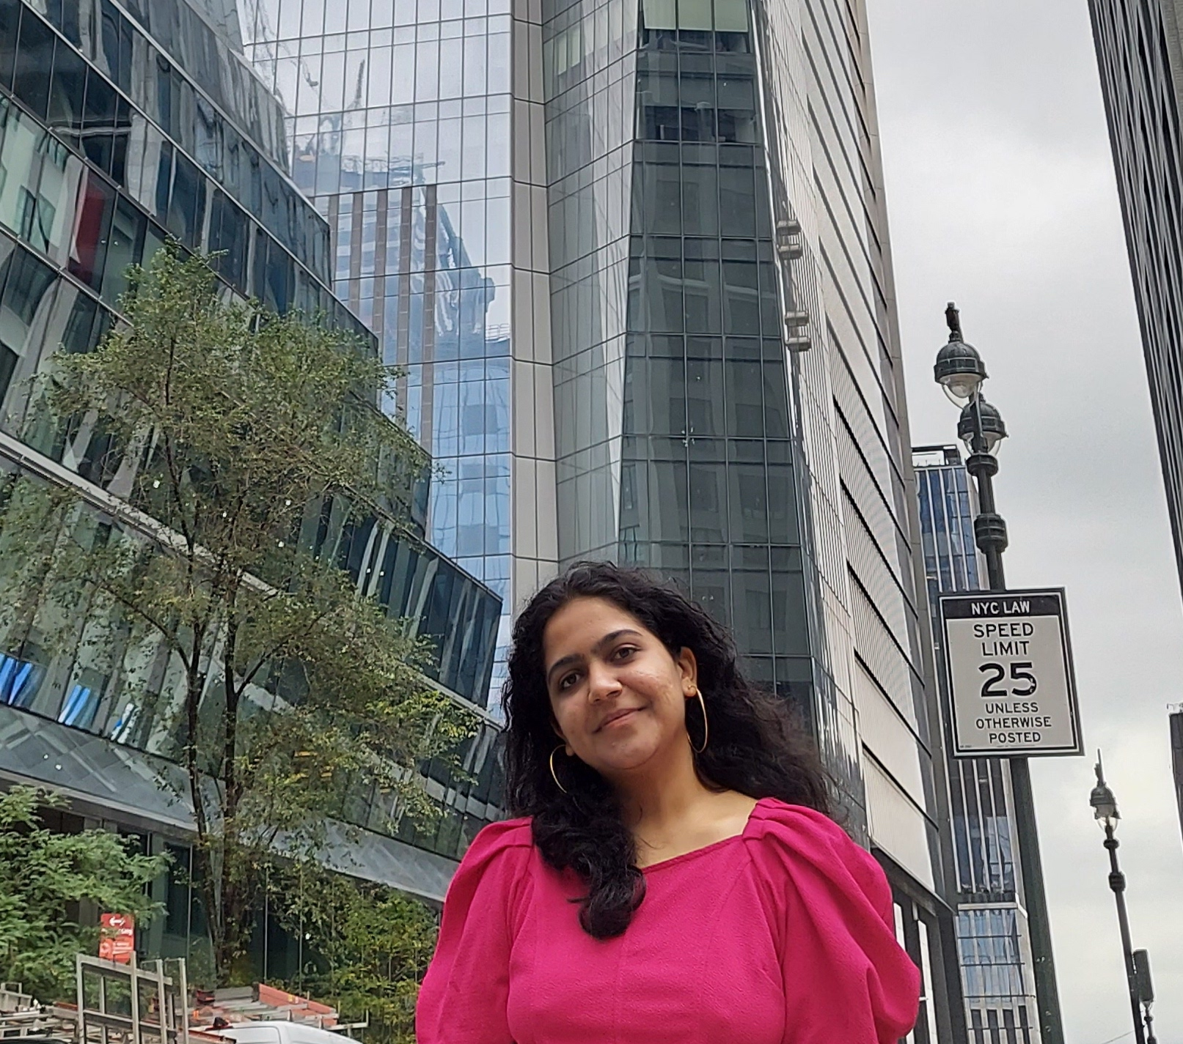

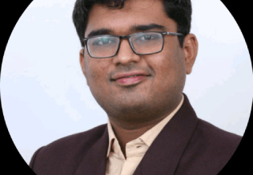
THANKYOU
Pulkit Varshney
Pratik Thorwe
Purva Makarand Mhasakar
Saurabh Parekh

Slide 20
https://web.microsoftstream.com/video/a2e73733-5b6a-477b-89a2-55571cf55b8f

Slide 21
